Slide 1
Inverter

Slide 2
Inverter
A circuit that converts dc power into ac power at desired output voltage and frequency is called as Inverter
The power input to the inverter is obtained from an existing power supply network or a battery, fuel cell, PV array, etc.
BJT's, PMOSFET's, ICBT's are mainly used - they can be turned off by the control of their base current
Switching off of the devices with the help of their gate or base current is called self commutation.
Applications: Induction heating, air craft power supplies, UPS, etc.,

Slide 3
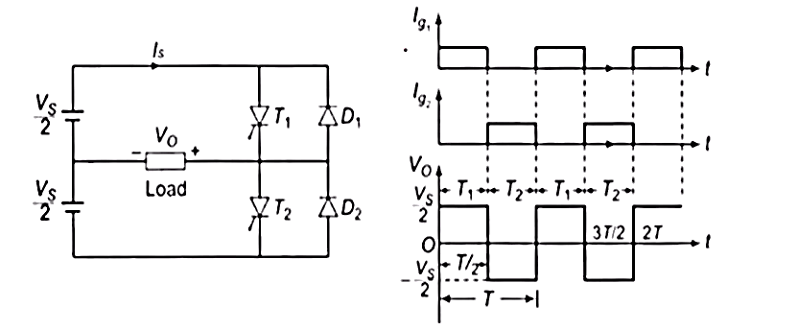
Half bridge Inverter- Working
Assumption: Thyristor conducts for the duration its gate pulse is present and commuted as soon as this pulse is removed
Single phase half bridge inverter consists of two SCP's, two diodes and three wire supply.
Main drawback of this half bridge inverter is that it requires 3-wire dc supply
1= half bridge inverter
Waveforms of gate pulses and output voltage

Slide 4
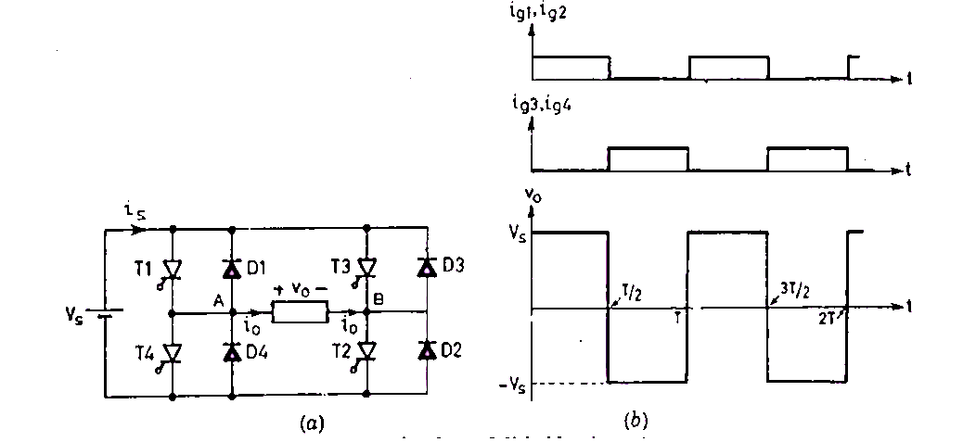
Full bridge Inverter- Working
Single phase Full bridge inverter consists of four SCP's and four diodes.
The number of thyristors and diodes is twice of that in a half bridge inverter
Each SCP's is connected with a feedback diode

